Slide 2
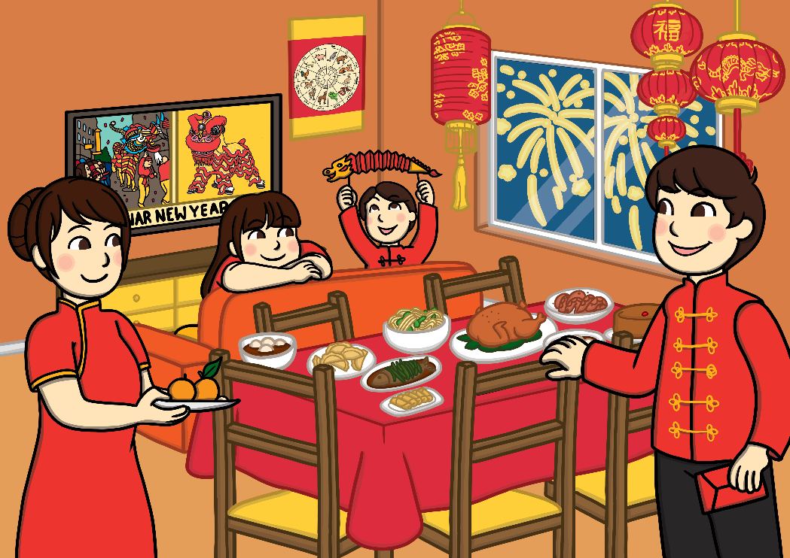
What is Chinese New Year?
Chinese New Year is the start of the new year in the Chinese calendar. As it is celebrated by other countries too, it is often called the Lunar New Year or Spring Festival.
Chinese New Year is celebrated on a different date each year.
It can be celebrated between 21st January and 20th February.
This is because it starts at the beginning of the first new moon.

Slide 3
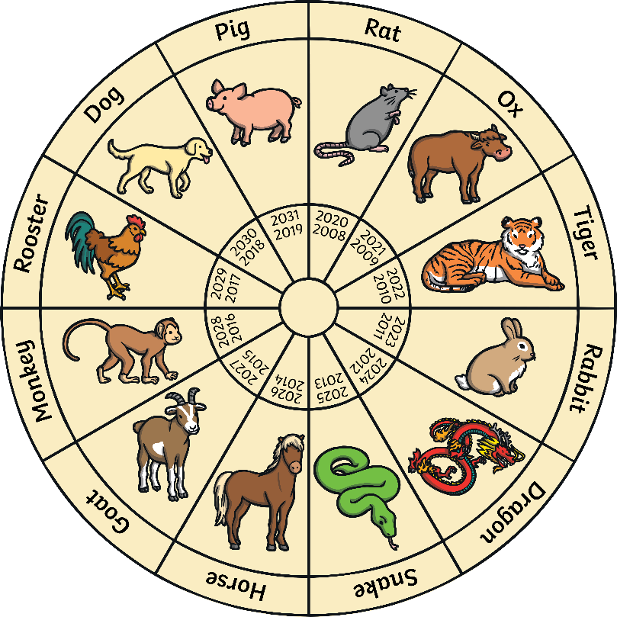
Chinese Zodiac
Each new year is named after an animal from the Chinese New Year story.
When I was born, it was the year of the…

Slide 4
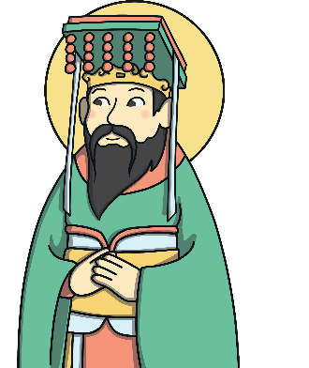
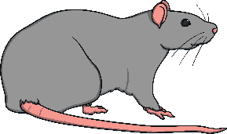
How did the animals on the Chinese zodiac get chosen?
The Chinese New Year story tells of how the animals in the Chinese zodiac were chosen. The story begins with the Jade Emperor deciding to measure time by introducing a calendar, naming each year after an animal.
In the story, he invited lots of animals to enter a race to cross the river and the first 12 animals to finish the race would have a year named after them.
The rat was the first animal to cross the river so, the first year was named after the rat. The tiger came third in the race.

Slide 5
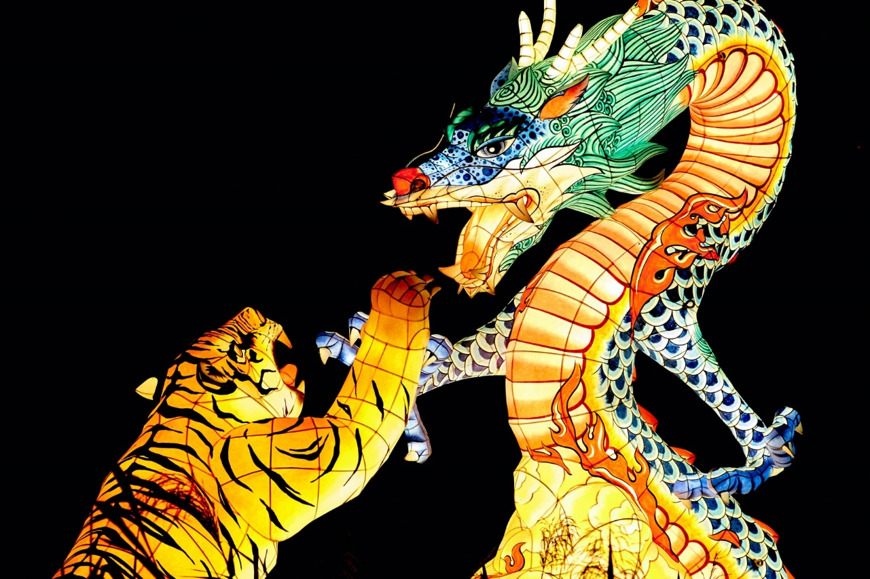
Tigers in Chinese Culture
For a long time, people in China have admired tigers for their strength and beauty. Tigers are thought of as the king of all beasts in China.
Tigers appear in many old Chinese stories.
Paintings of tigers are sometimes hung in temples and people’s homes.

Slide 6
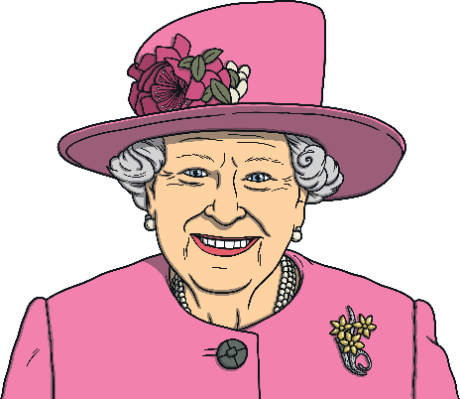
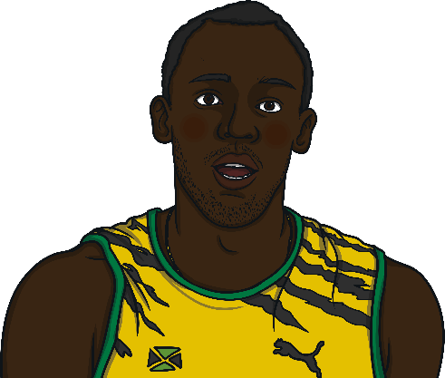
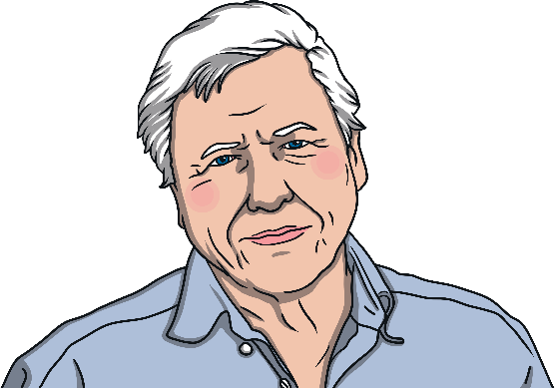
Year of the Tiger
There are lots of famous people born in the year of the tiger.
Queen Elizabeth II
Usain Bolt
Sir David Attenborough
It is thought to be very lucky to be born in the year of the tiger.

Slide 7
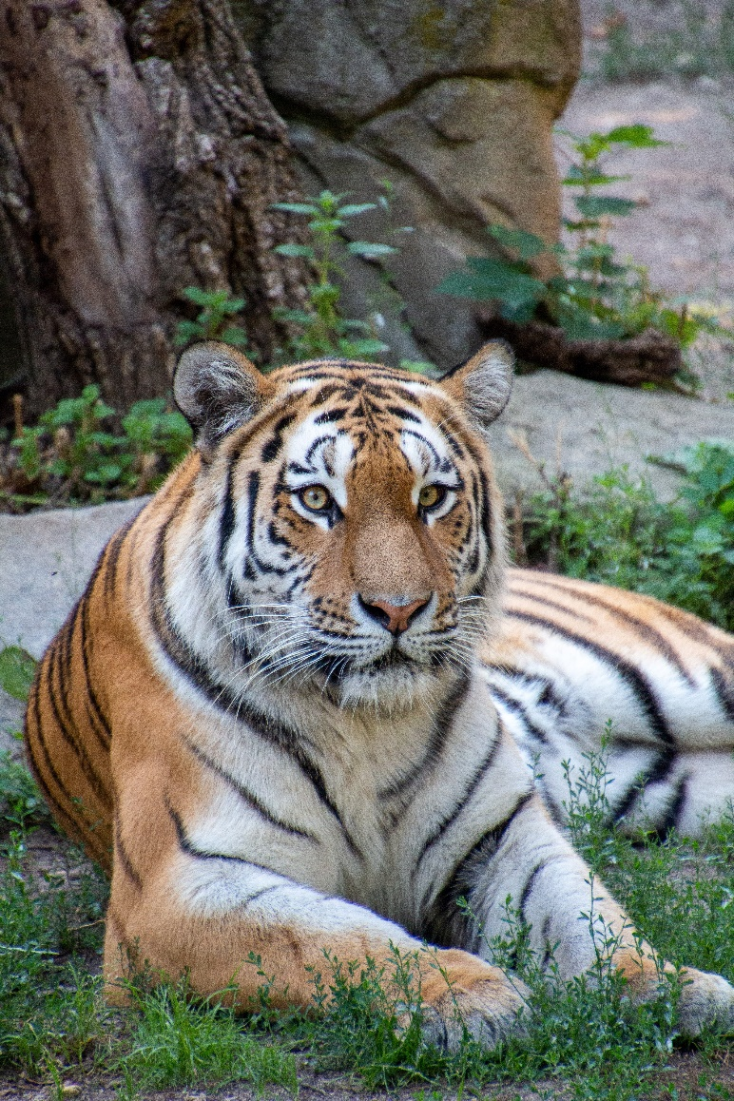
Year of the Tiger
Do you know any facts about tigers?

Slide 8
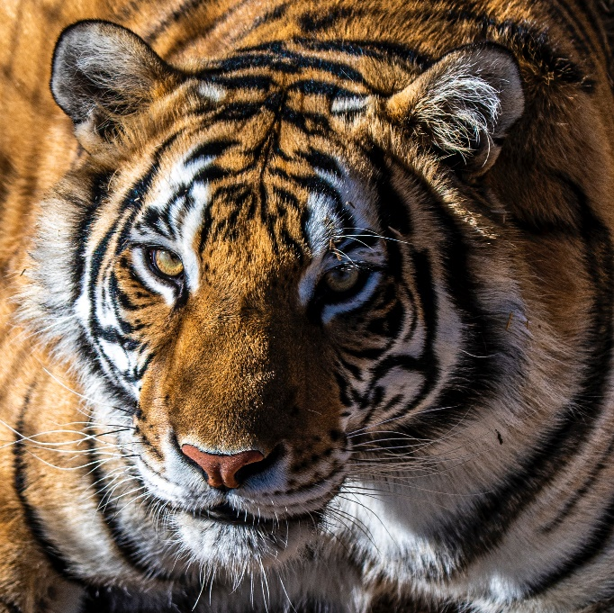
Tiger Facts
Tigers are the largest of the big cat family.
They have a unique orange fur with black stripes.
Every tiger’s fur pattern is different!

Slide 9
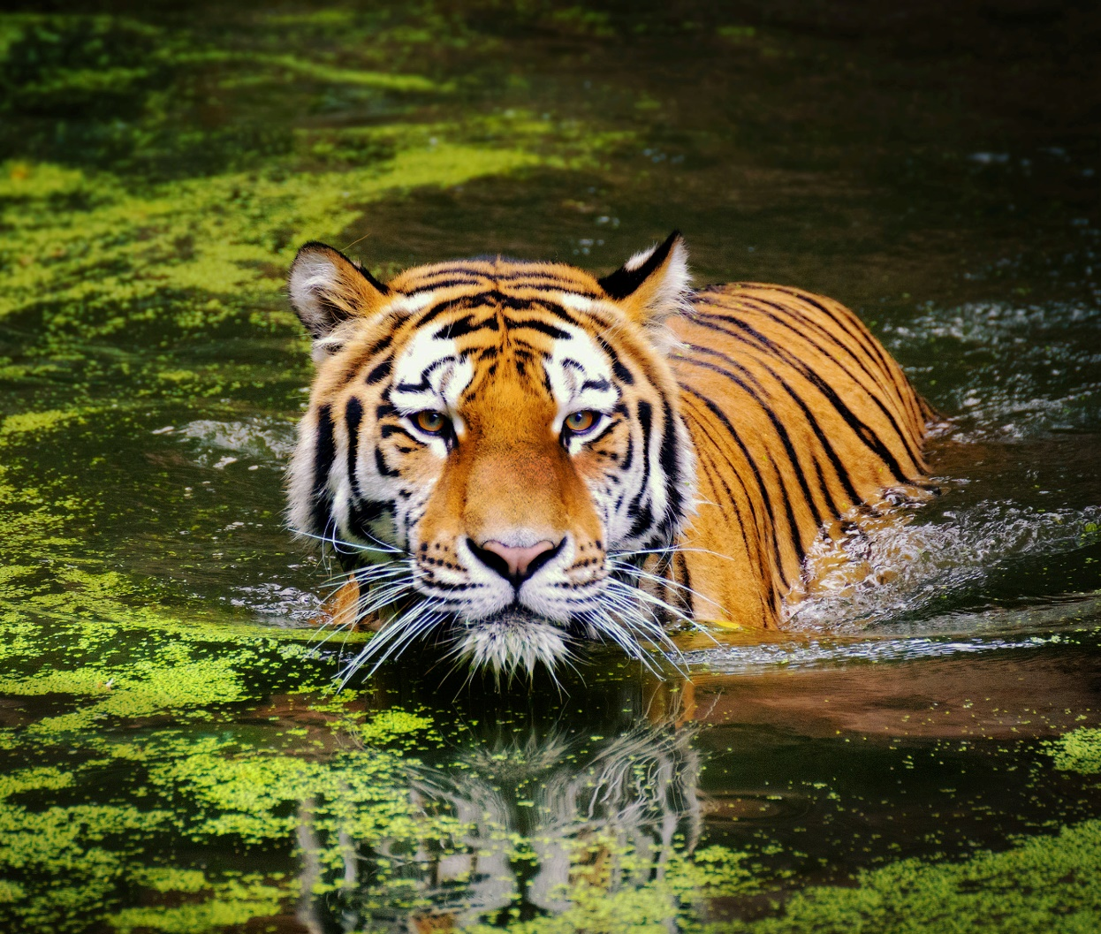
Tiger Facts
Tigers are very fast animals and they are great swimmers too!

Slide 10
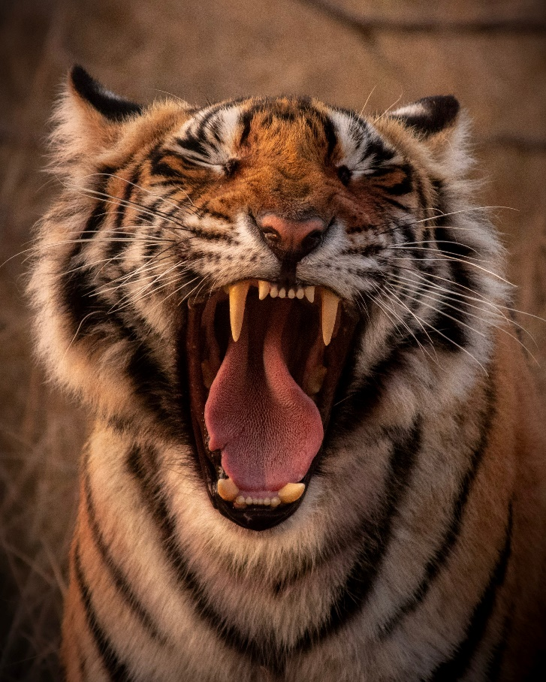
Tiger Facts
Tigers communicate by making different noises, such as roars, growls, snarls and grunts.
A tiger’s roar is so loud that it can be heard over three kilometres away.

Slide 11
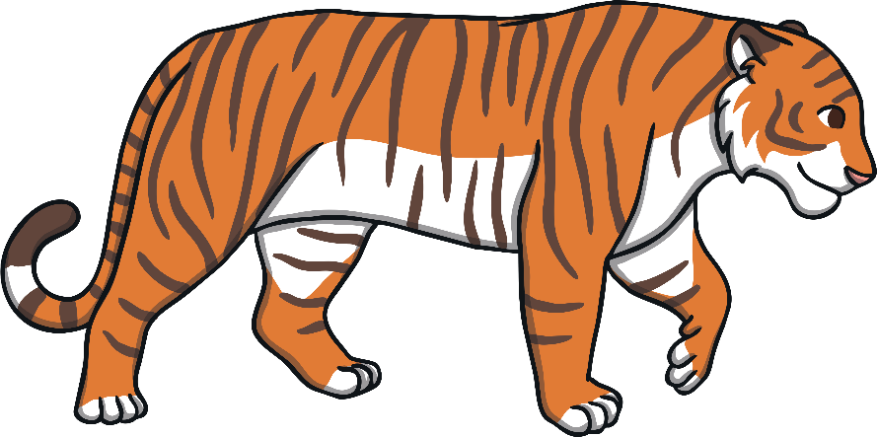
Tiger Facts
Tigers are mostly found in Asia and have lived there for a very long time.
Bengal tigers are the most common type of tiger.

Slide 12
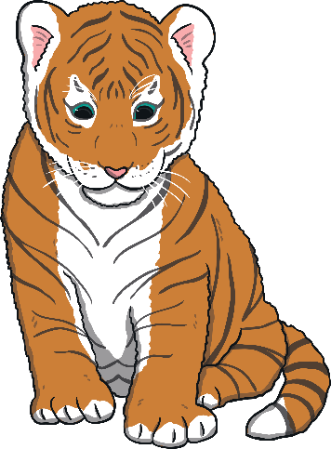
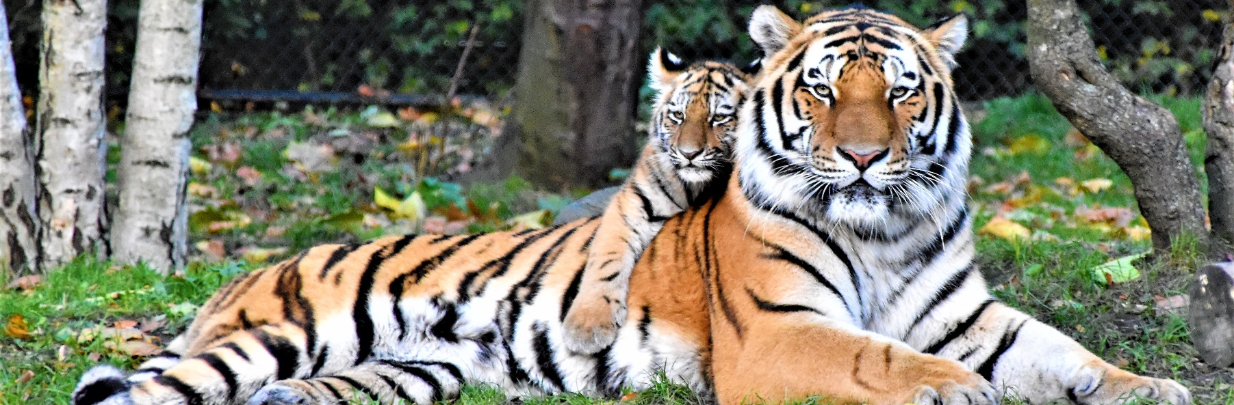
Tiger Facts
A baby tiger is called a cub.
Cubs only open their eyes for the first time 1 to 2 weeks after they are born.
A tiger cub will stay with its mum until it is 18 months old.

